Slide 1

Software-Defined Networking
University of Trento Department of Information Engineering and Computer Science June 2024
La Rosa Francesco
Meneghin Mattia Muka Diamand

Slide 2
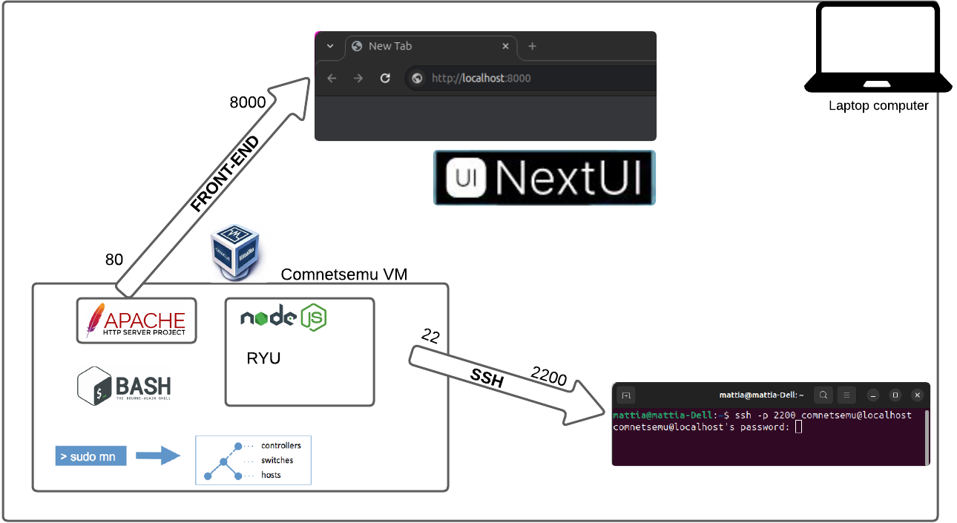
Infrastructure

Slide 3
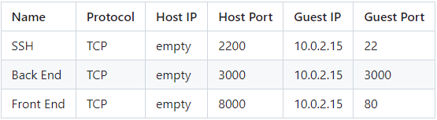
Environment
All is running in a Ubuntu Focal Fossa (20.04) VirtualBox Machine that has
Apache2: the service in charge of expose the frontend on the port 8000
Node Js: the service that runs the backend through Express using port 3000
For convenience we decided to work with local terminals in ssh (port 22)
Thus the NIC of the VM is configured with this port forwarding:

Slide 4
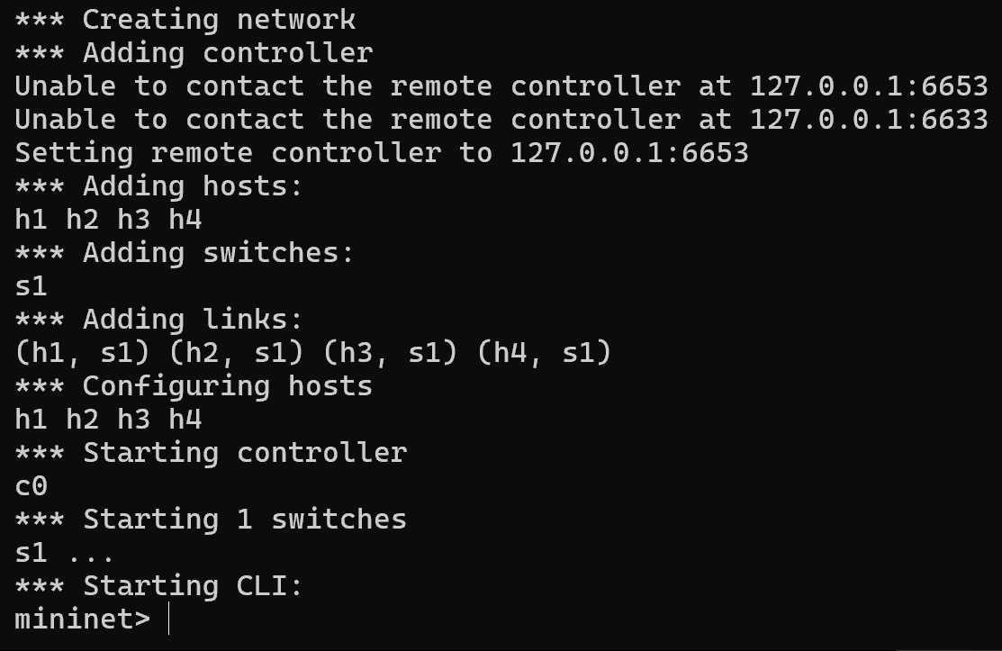
Comnetsemu: a custom Mininet service
Comnetsemu is a virtual environment where through Mininet technology you can work with Software-Defined Networking
Allows:
Emulation
Flexibility
Integration with SDN controllers

Slide 5
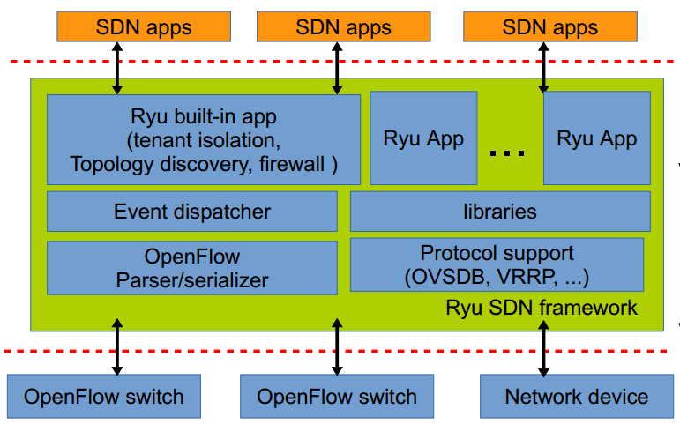
Ryu Manager: SDN framework
It provides software components and libraries in order to build SDN applications. Key features of Ryu include:
Controller Platform: Ryu serves as an SDN controller that communicates with network devices using protocols (e.g. OpenFlow)
Rich API: Ryu provides a rich set of APIs to manage network devices and handle network traffic.
Extensibility: Developers can easily extend Ryu to support new protocols and network management tools.
Active Development: Ryu is actively maintained and developed, with a growing community contributing to its improvement.

Slide 6
Script start.sh
Through the start.sh script it’s possible to run the whole project without launching (at least) 3 commands.
Steps to run
Boot the machine
Connect to the environment using SSH
run the start.sh
Navigate the http://localhost:8000 and it will show the default network

Slide 7
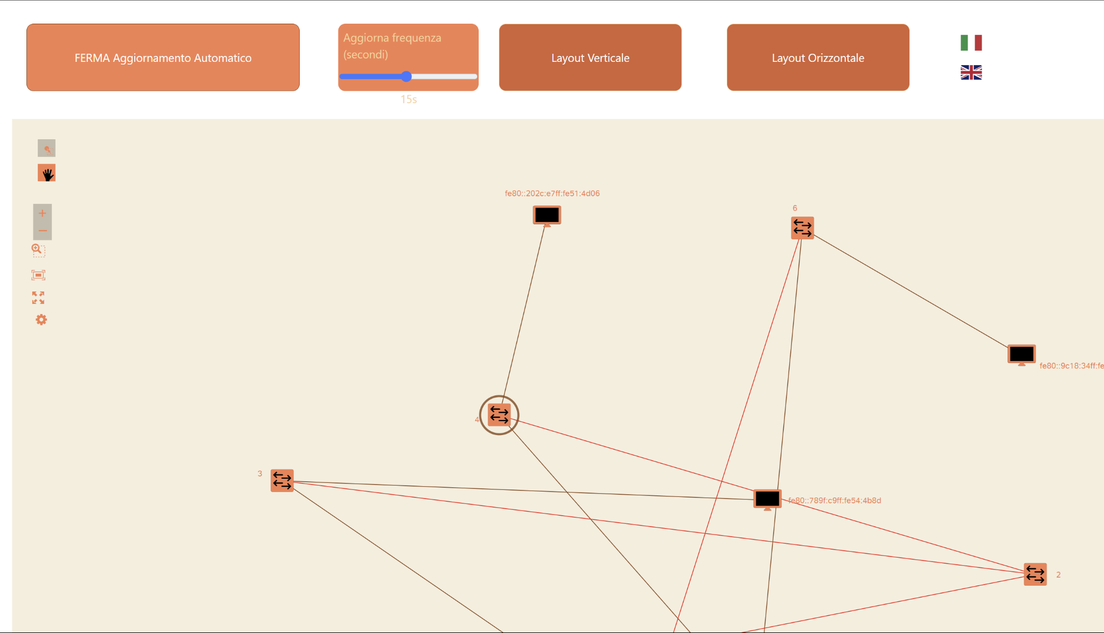
FrontEnd
The FrontEnd part is organized in a Html,and a group of various folders that contains the various modifier and script that let our webapp run.For the script part we preferred to use Vue.js for the UI,Axios for the Http request and a bootstrap snippet for the reactive design. The system visualize the topology of the selected backend view letting us known the information in real time about switch and host

Slide 8
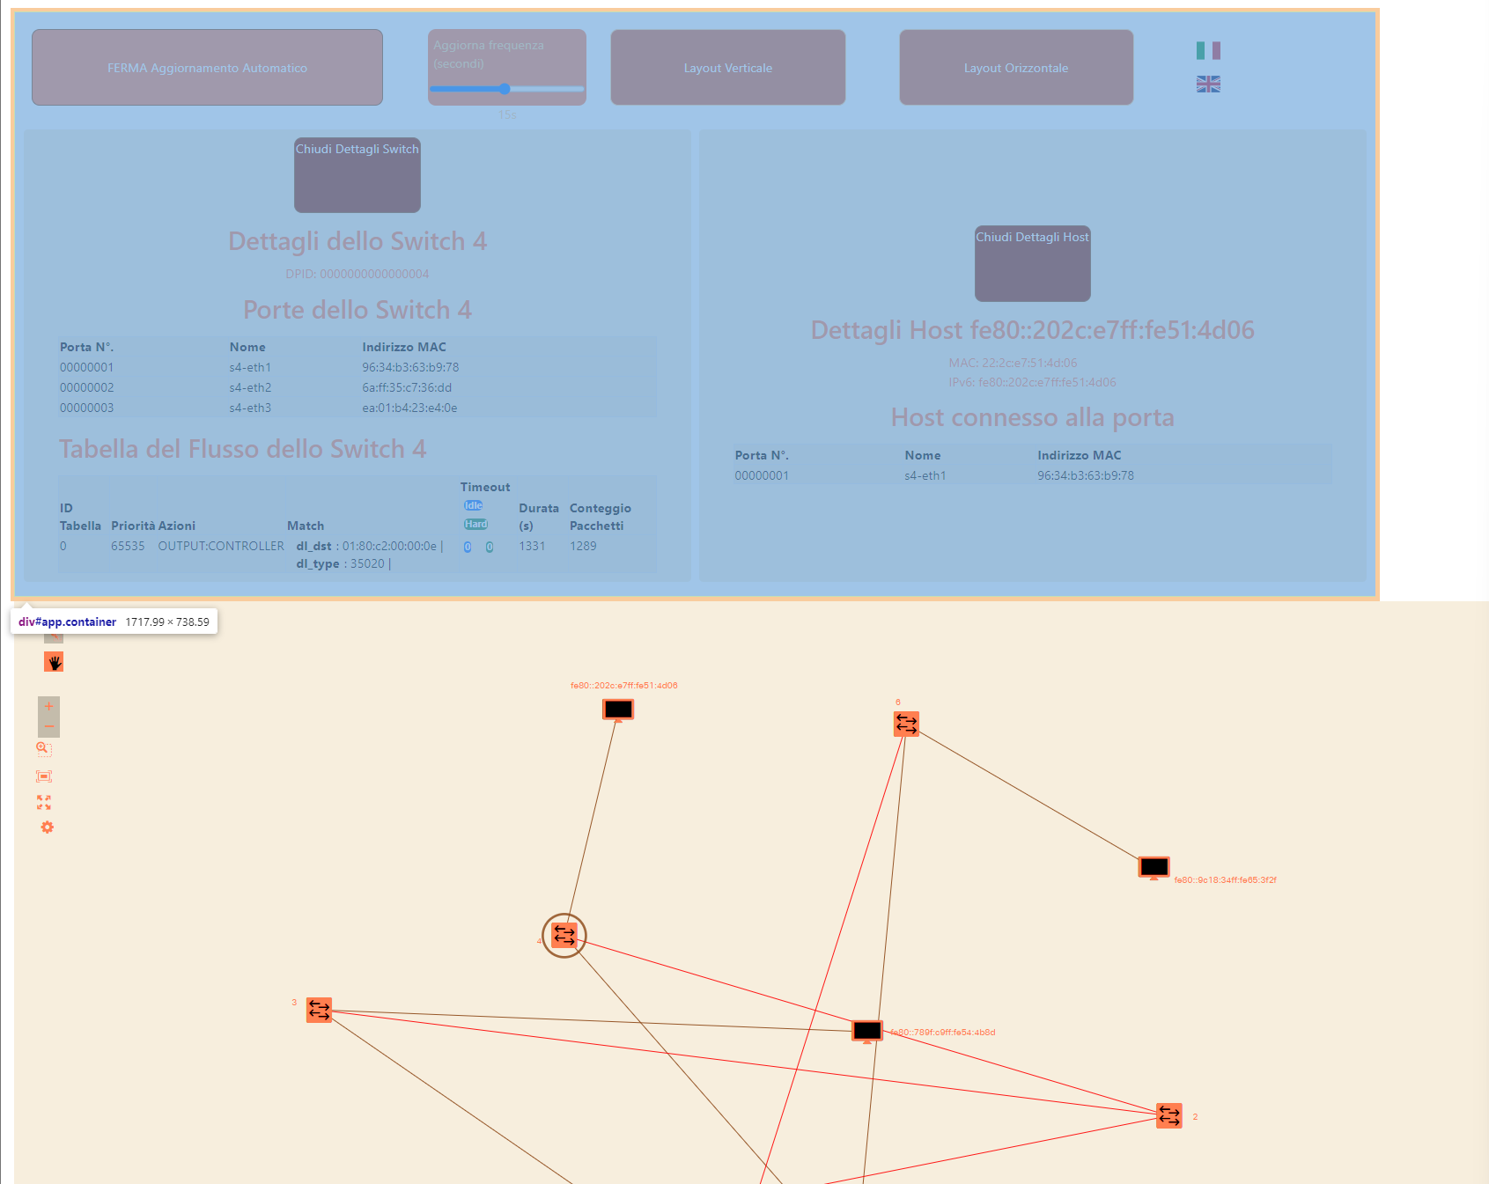
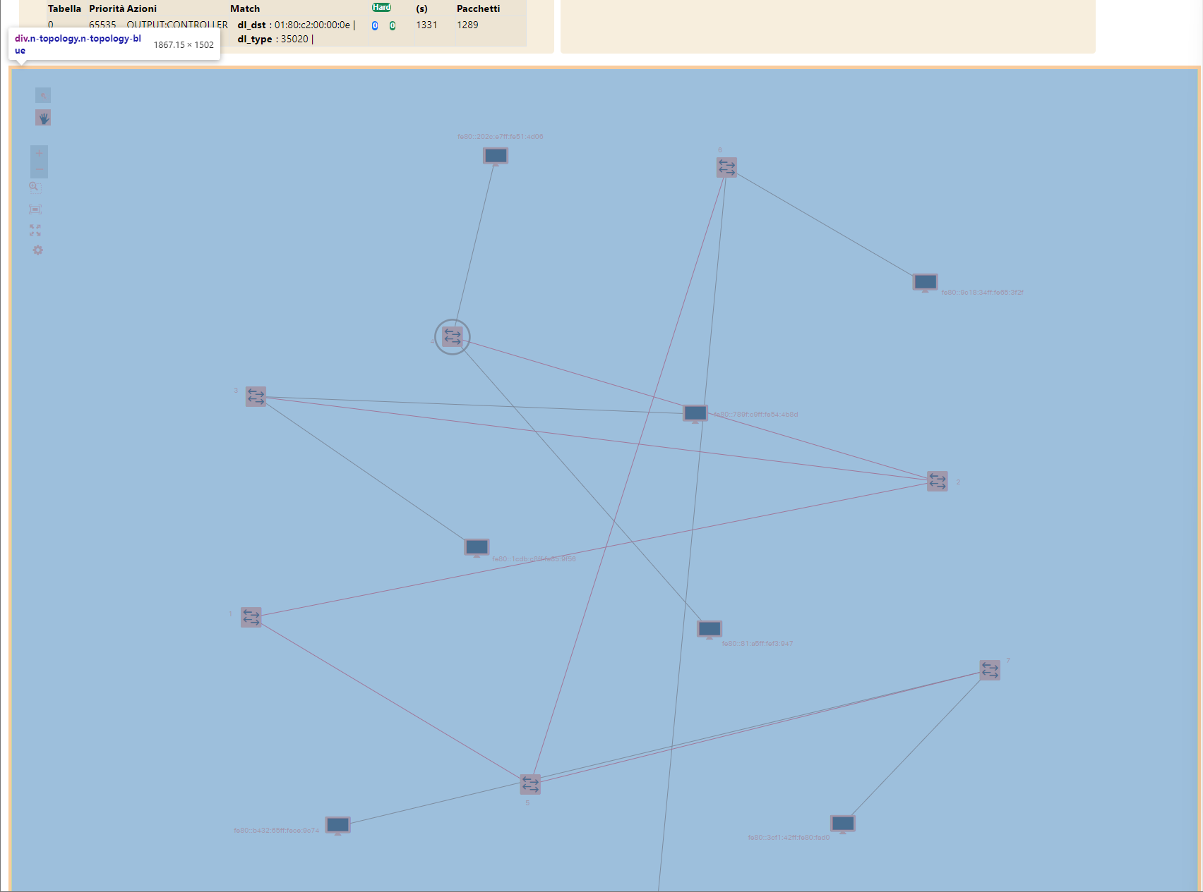
Html Structure
The “app” part that is the container of the Vue part(app.js):the button to start & stop the auto-update, and other 2 for the layout pre-configurations and then the subsection that show us the info of the selected switch or host
The dynamic part “n-topology” monitored by topology.js that let us view the topology as displayed,change the position of the different switch and host in a custom one.

Slide 9

Javascript used
App.js It manages the Vue part of the app:
State of topology display: Horizontal or vertical mode
Automatic update with start and stop dynamic button
Network socket precise details.With the possibility of hiding or showing the info of a selected one
LoadTranslation with the omonimous function js it set automatically the button and some extra names to the preselected language
Topology.js
It manages the recovery of the data from the backend and proceed to the construction of a dynamically adjustable schematics of the network
get_host
get_switches
get links
get_flow_table it recovers the specific flow of a switch
build_topology set the rules for the structure of the topology:nodes and links

Slide 10
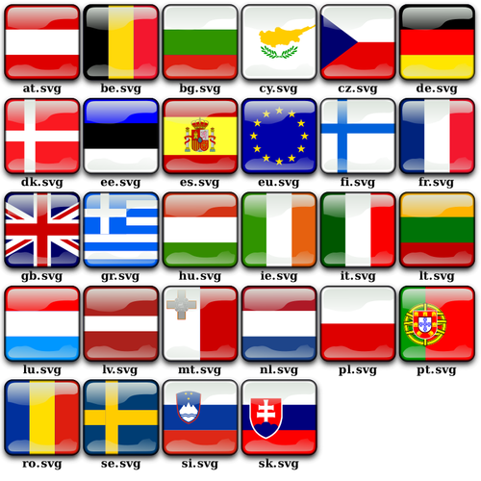
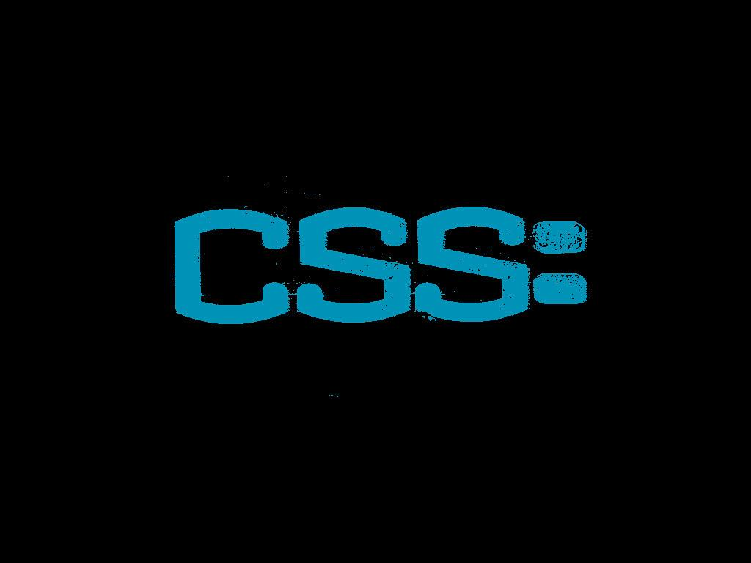
Css & json + Translation.js
The translation.js manage the traduction schemas of the application,loading the info from the json file and updating the text of the UI based on the language selected.The .json file has the various traduction from various languages(For now only En and It) mapping the key to the respective text block in the Html
Next.css and addingStyle.css
The next.Css is the css given by the next lib that preset some style used in our object,but those style are overwritten(when needed) by ours like the other css does with the !important attribute. We studied a lot of interpolation and colour scheme to be more accurate and User compatible.

Slide 11
Functional demonstration:
When the topology is initiated will be executed the function init_topology that will take the initial data from backend of the host , switch and link creating a representation in the n-topology container Then,when the user will interact with the nodes, it will be displayed the specific details of the switch or host,with the top center and top right button that will set a particular view of the nodes. Every 5 seconds(if not changed) if the trigger “Automatic Update” is active all the data will be updated to match the new status if some sort of change has happened.

Slide 12
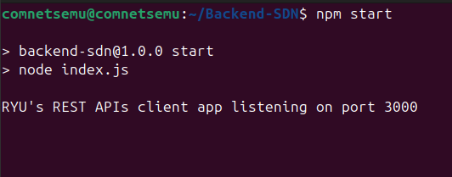
(1) Commands: Start the backend
npm start

Slide 13
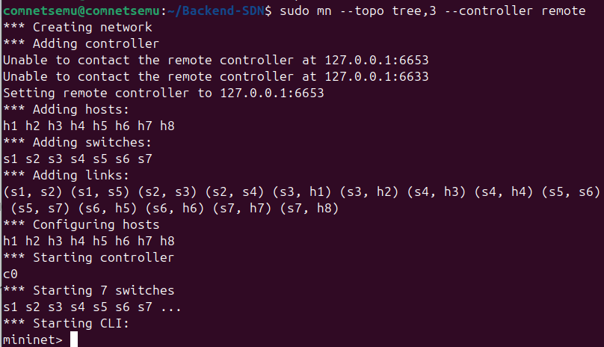
(2) Commands: Start the Software-Defined network
In another terminal:
sudo mn –topo tree,3 –controller remote

Slide 14
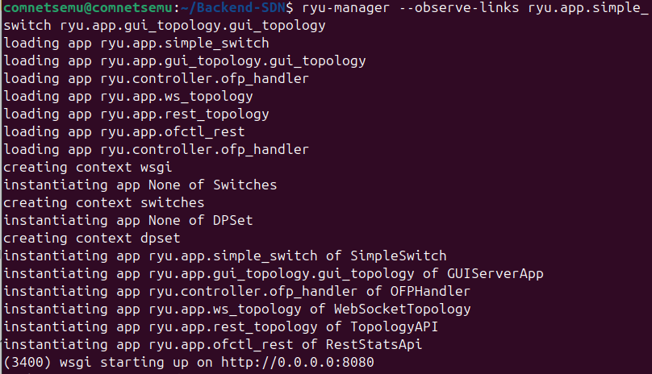
(3) Commands: Start the Ryu controller
In another terminal:
ryu-manager --observe-links ryu.app.simple_switch ryu.app.gui_topology.gui_topology
Ryu is a basic OpenFlow controller framework written in Python. With this command ryu is set as remote controller

Slide 15
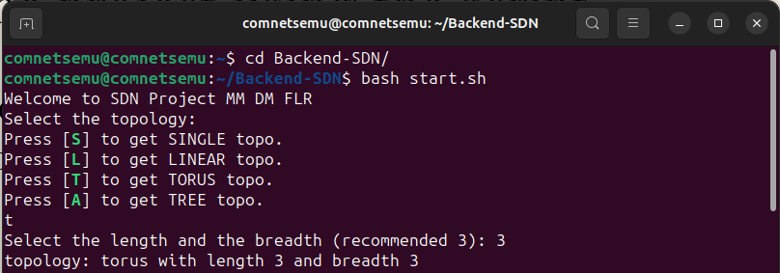
Run the project using the script
Thanks to this script there is the possibility to run the project selecting dynamically the network topology to show

Slide 16
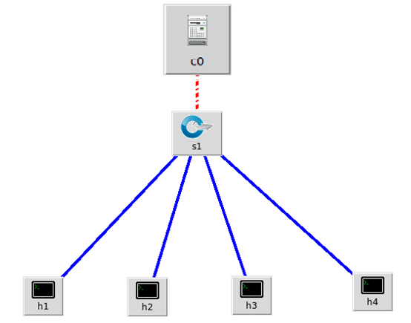
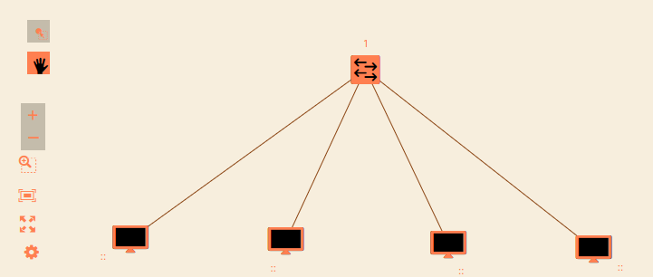
Single Topology (S selection)
Parameters
number of hosts
Single topology with 4 hosts

Slide 17
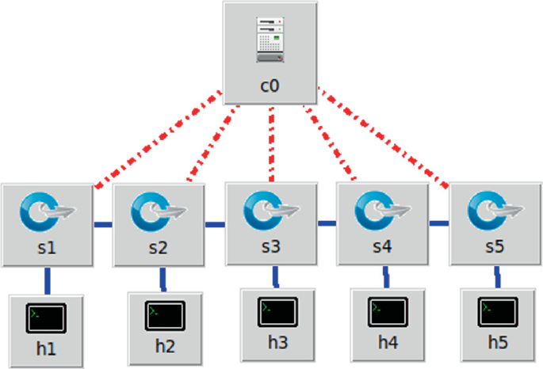
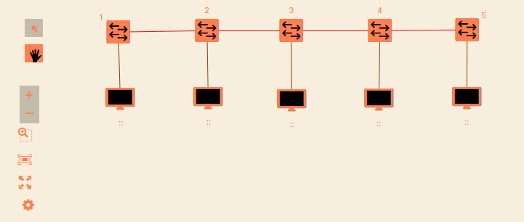
Linear Topology (L selection)
Parameters
number of switches
Linear topology with 5 switches

Slide 18
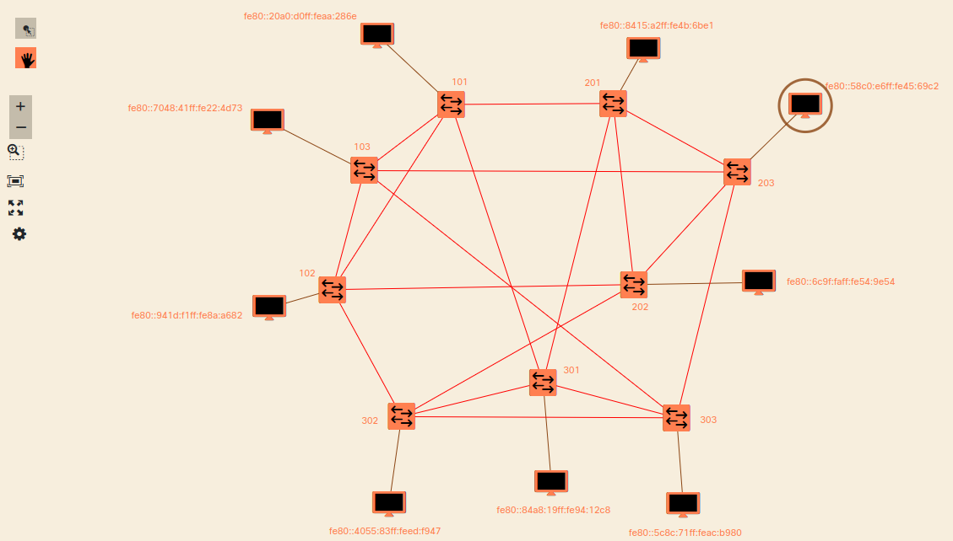
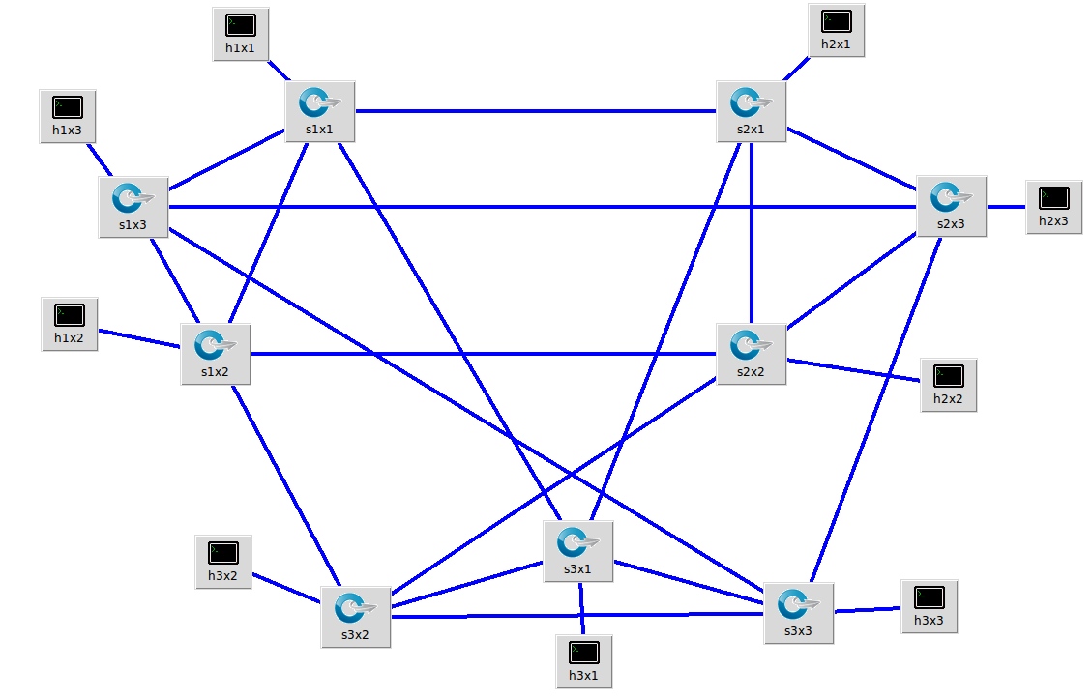
Torus Topology (T selection)
Parameters
length
breadth
* Torus topology want a square as parameters
Torus topology with length = 3 and breadth= 3

Slide 19
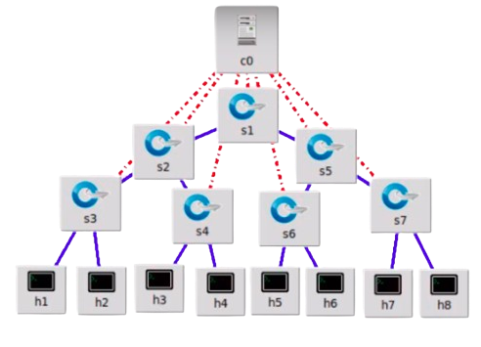
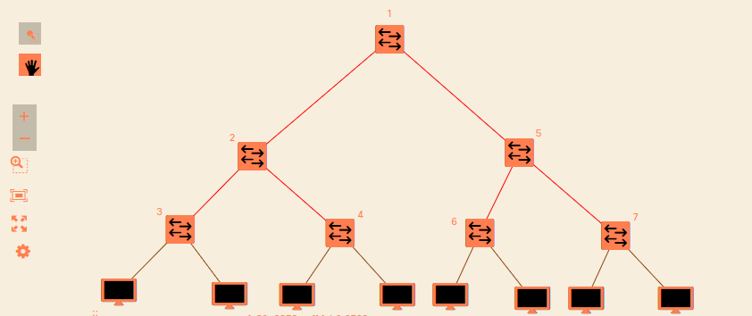
Tree Topology (A selection)
Parameters
depth
fanout
Tree topology with depth = 3 and fanout = 2

Slide 20
Custom Topology
If you want to test your custom network you can develop your network and show it using this web application through this command:
sudo mn --custom ~/mininet/custom/project.py --topo=project
Example of code:
from mininet.topo import Topo
class Project( Topo ):
def __init__( self ):
# Initialize topology
Topo.__init__( self )
# Add hosts
h1 = self.addHost('h1')
... # Add switches
s1 = self.addSwitch('s1') … # Add links
self.addLink(h1,s1) … topos = { 'project': ( lambda: Project() )}

